Slide 1
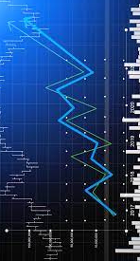
Stock Portfolio Optimization
Professor:
Dr. Christos Zacharias
Department of Management Science Miami Business School University of Miami
Prepared by
Zhao Chen
Jacquline Reily
Elaheh Mahiantoosi

Slide 2
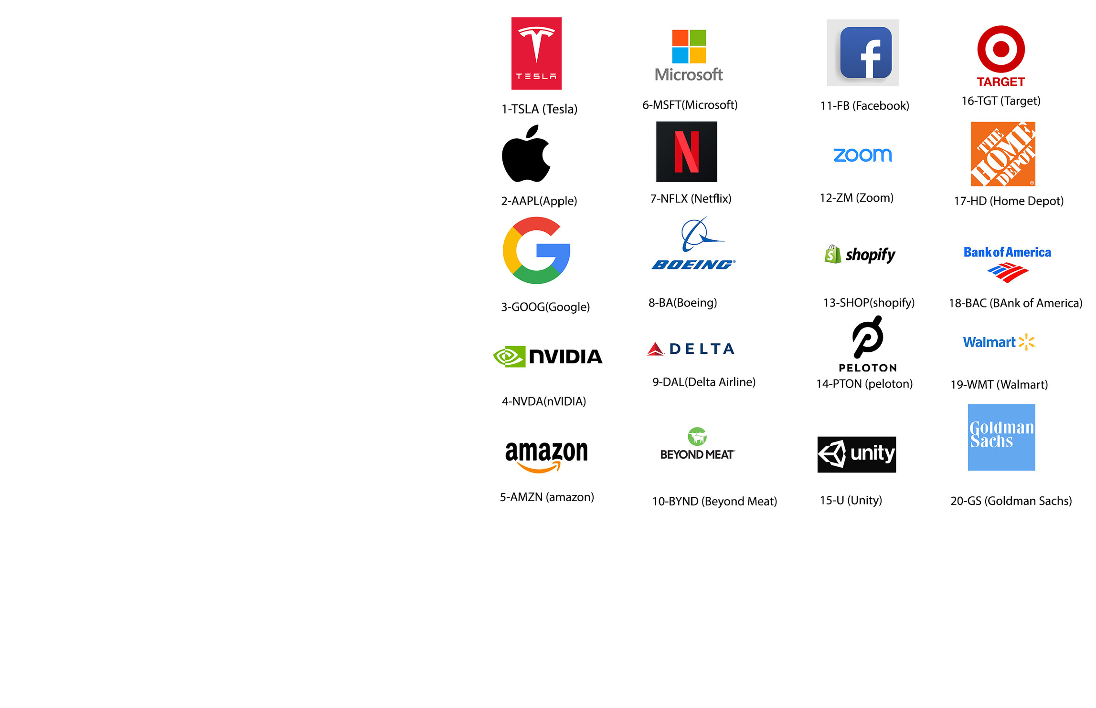
Resource
Page

Slide 3
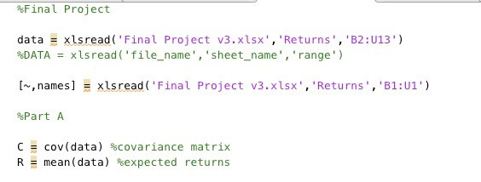
Average return & the covariance matrix Script

Slide 4
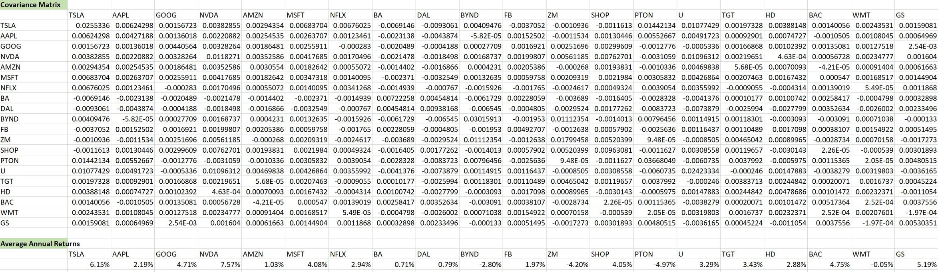
Average Monthly Return(Excel)

Slide 5
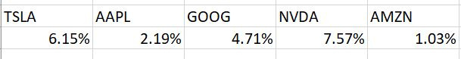
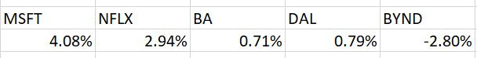
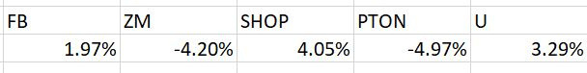
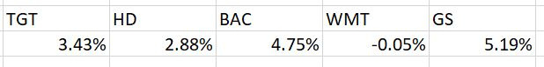
Average Return
Here is the average return based on the last 12 months in which TSLA has the highest return by 6.15% and PTON with the least rate of return by -4.97

Slide 6
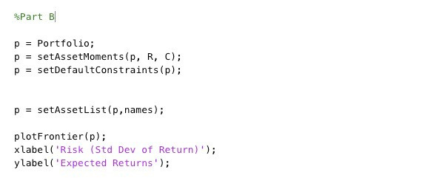
Frontier Script

Slide 7
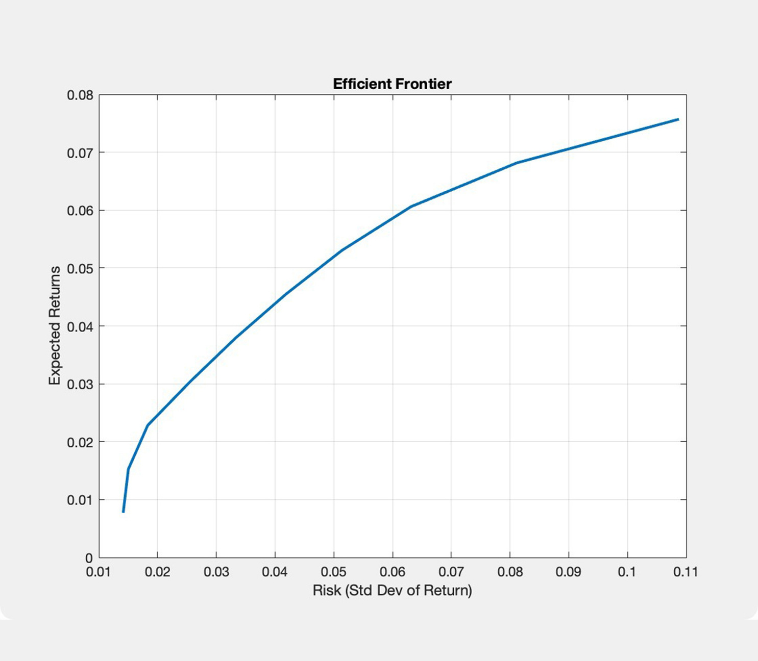
Frontier Plot
Based on the minimum variance , here is the efficient frontier of our optimal portfolio.
Our efficient frontier is the set of optimal portfolios that offer the highest expected return for a defined level of risk or the lowest risk for a given level of expected return.

Slide 8
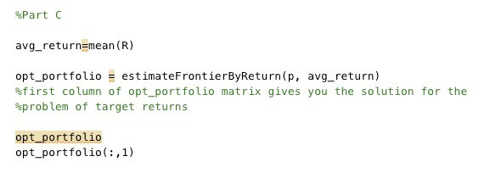
Optimal Portfolio
Solved the optimal portfolio based on setting the target return to be equal to the average return across all stocks

Slide 9
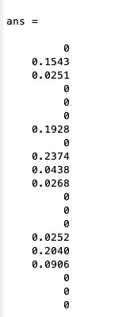
Optimal Portfolio
Solved the optimal portfolio based on setting the target return to be equal to the average return across all stocks

Slide 10
Optimal Portfolio
01
AAPL 15%
GOOG 2.5%
NFLX 19%
DAL 23%
BYND 4%
FB 26%
U 2.5%
TGT 20%
HD 9%
02
03
Based on setting the target return to be equal to the average return we need to choose the front mentioned variables for our optimal portfolio to invest.The highest percentage is for FB and least for GOOG and U.
04
05
06
07
08
09

Slide 11

Portfolio Optimization Against a Benchmark

Slide 12
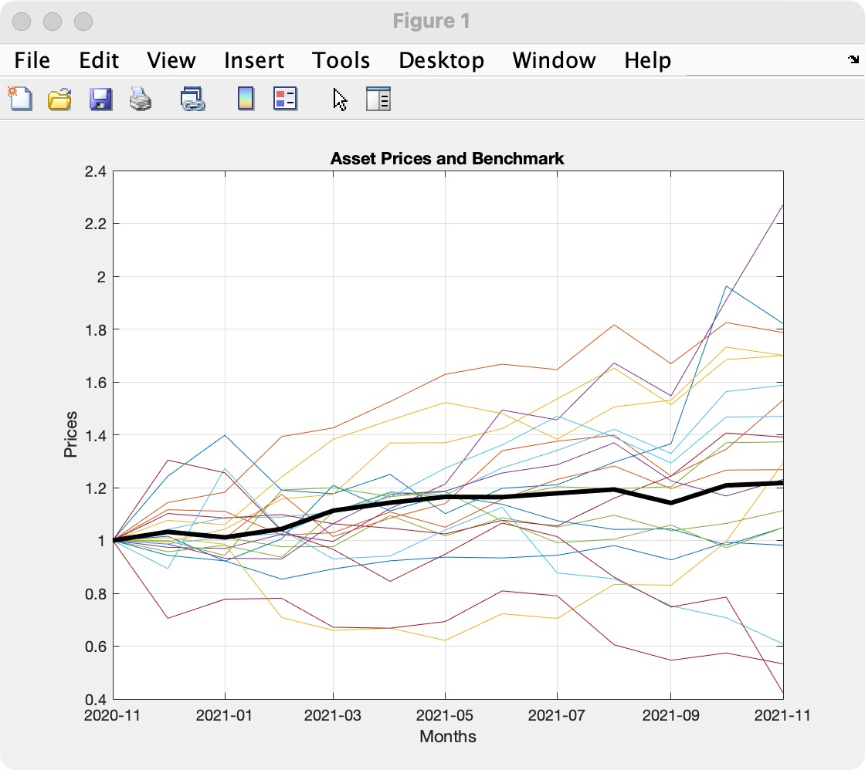
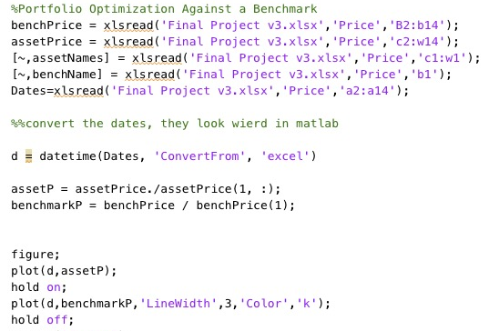
Add Dow jones historical data as a Benchmark

Slide 13
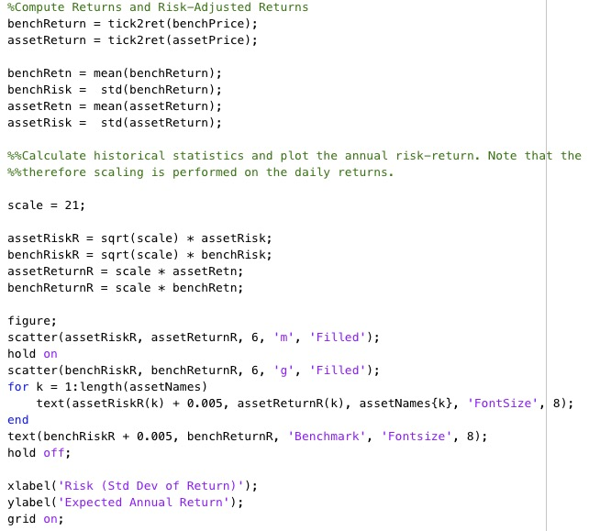
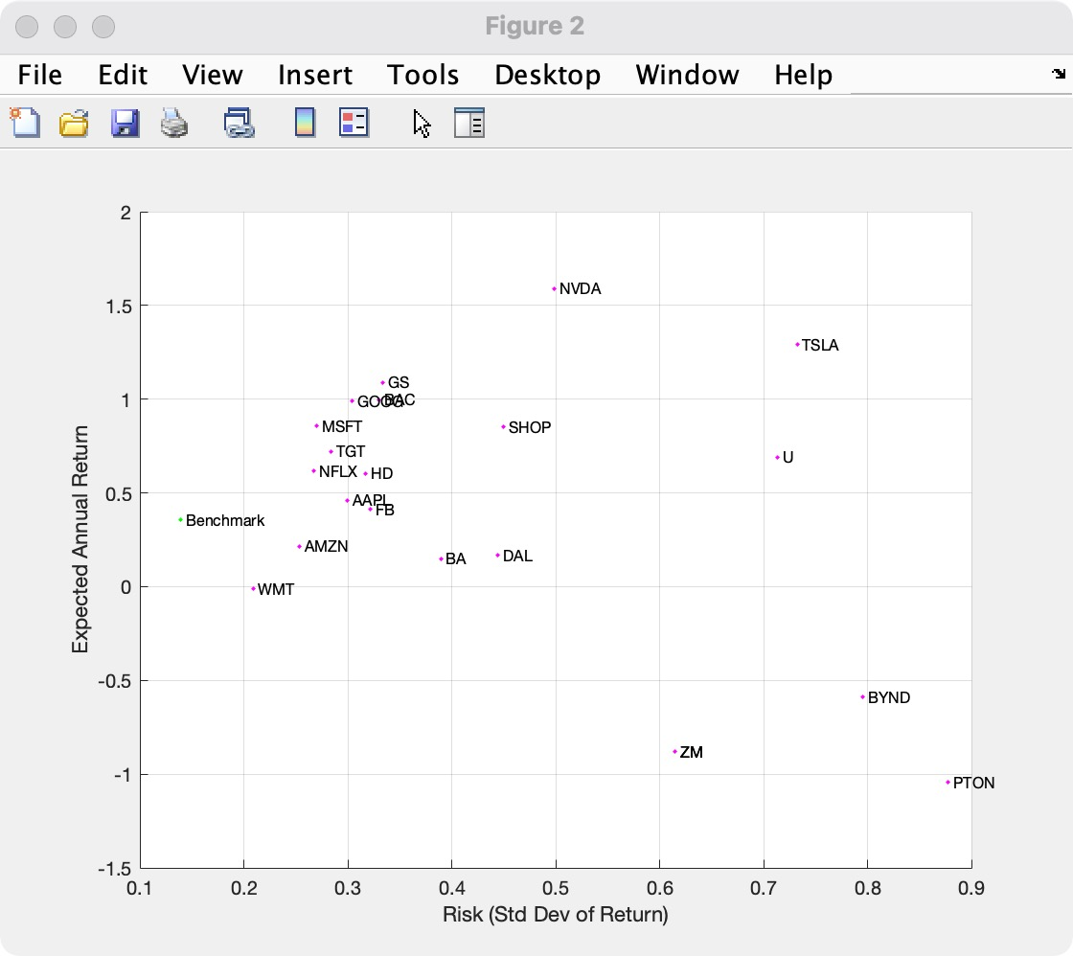
Compare the benchmark and 20 portfolio

Slide 14
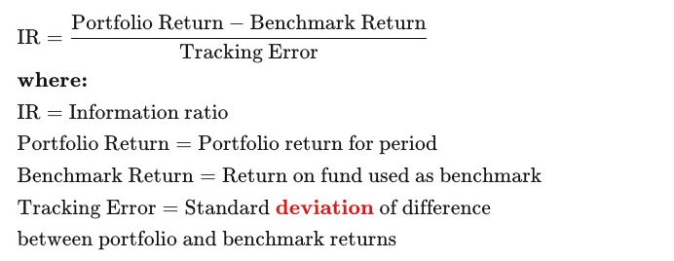
Information Ratio-IR
The information ratio (IR) is a measurement of portfolio returns above the returns of a benchmark, usually an index such as the S&P 500, to the volatility of those returns
The information ratio is used to evaluate the skill of a portfolio manager at generating returns in excess of a given benchmark
A higher IR result implies a better portfolio manager who's achieving a higher return in excess of the benchmark, given the risk taken
Notes:
Set up a portfolio optimization problem by populating the object using Portfolio. Because the goal is to optimize portfolio allocation against a benchmark, the active return of each asset is computed and used in the Portfolio object. In this example, the expected returns and covariances of the assets in the portfolio are set to their historical values.

Slide 15
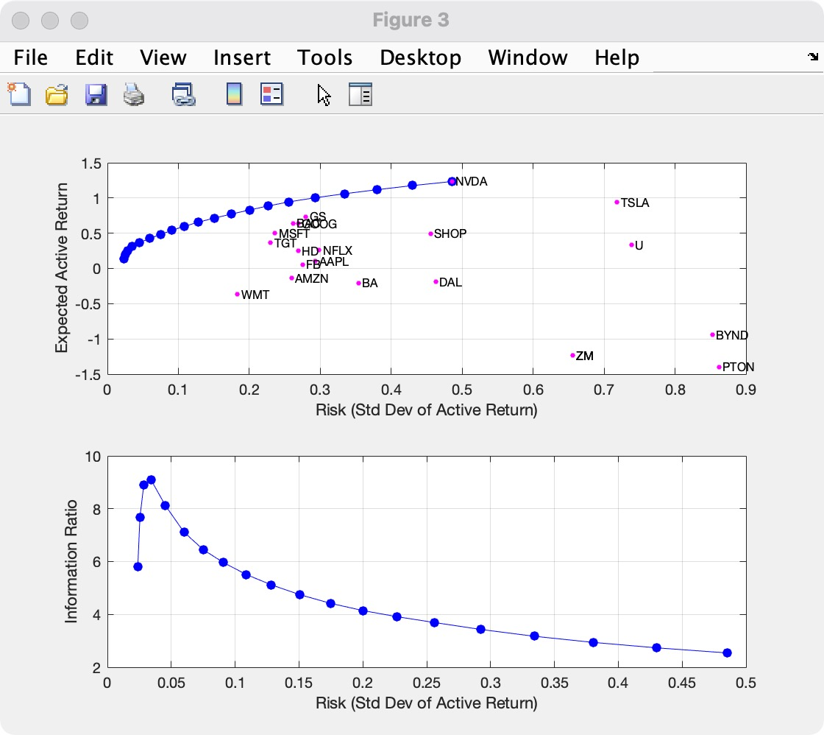
Compute the Efficient Frontier Using the Portfolio Object
Compute the mean-variance efficient frontier of 20 optimal portfolios.
Visualize the frontier over the risk-return characteristics of the individual assets.
Furthermore, calculate and visualize the information ratio for each portfolio along the frontier.

Slide 16
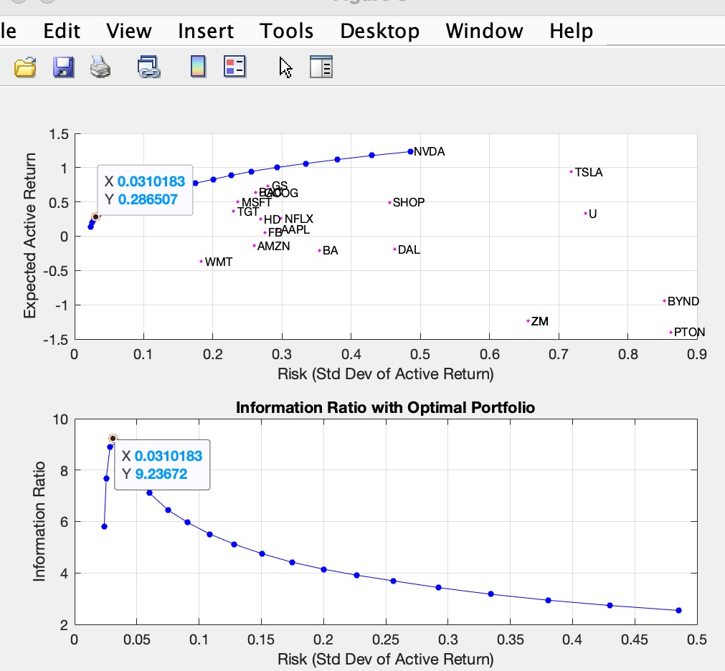
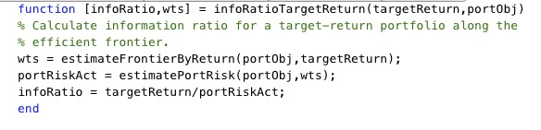
Plot the Optimal Portfolio
The infoRatioTargetReturn local function is called as an objective function in an optimization routine (fminbnd) that seeks to find the target return that maximizes the information ratio and minimizes a negative information ratio.
Notes:
Run a hybrid optimization to find the portfolio along the frontier with the maximum information ratio. The information ratio is the ratio of relative return to relative risk (known as "tracking error"). Whereas the Sharpe ratio looks at returns relative to a riskless asset, the information ratio is based on returns relative to a risky benchmark, in this case the DJI benchmark. This is done by running an optimization that finds the optimal return constraint for which the portfolio optimization problem returns the maximum information ratio portfolio. The portfolio optimization functions are called from an objective function infoRatioTargetReturn that is optimized by the Optimization Toolbox™ function fminbnd. The local function infoRatioTargetReturn calculates a minimum (active) risk portfolio given a target active return.
The infoRatioTargetReturn local function is called as an objective function in an optimization routine (fminbnd) that seeks to find the target return that maximizes the information ratio and minimizes a negative information ratio.

Slide 17
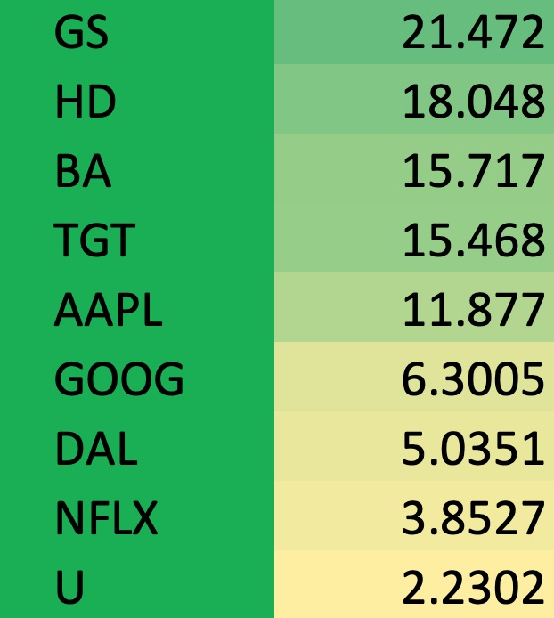
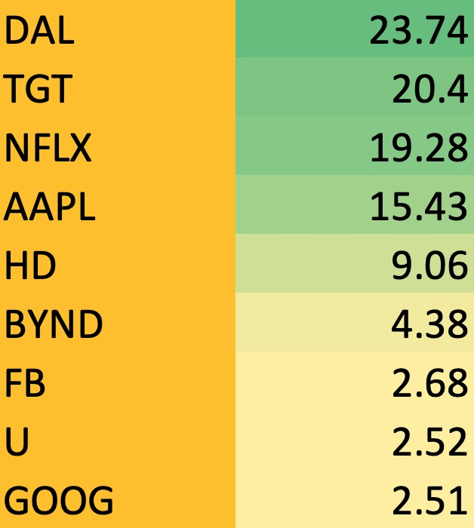
Maximum information ratio Portfolio
Target return: average return
Expected return: 28.7%
Expected risk: 3.1%
Expected return: 2.2%
Expected risk: 1.76%
Compare the Portfolio Optimization Solution

